Slide 1
3D & BIM Training Course
Room 210
1:15pm - 2:45pm
3:00pm - 4:30pm

Slide 2
Abstract (Hidden Slide)
3D & BIM
This hands-on training course will teach attendees how to create stunning 3D data with FME. Building on an overview, the course will work through basic workflows, advanced workflows, and discover some sample projects where 3D can be practically applied. Attendees will explore FME’s powerful 3D capabilities, turning data from GIS, CAD, BIM, and other common data sources into formats such CityGML, 3D PDF, and more.

Slide 3


Who Am I?
Christian Dahmen
  FME Consultant and Trainer
con terra GmbH, Germany
  Year of Employment: 2005
FME Certified Trainer since 2009
Membership in Professional Associations
  OGC CityGML SWG Charter Member
  Spatial Interest Group 3D (SIG 3D) Germany,
  Modeling and Quality Working Group

Slide 4
Who are you?
For how many years have you been using FME?
  < 1 year
  1 to 5 years
  > 5 years
Which 3D formats do you currently work with?
  CAD & BIM (DXF/ DWG, Revit/ IFC)
  Web Formats (3D PDF/ KML)
  GIS & Databases (Geodatabase, Oracle)
  CityGML

Slide 5
Agenda
Welcome & Organization
Part 1 - Basic workflows
  Chapter I: FME and 3D overview
  Chapter II: Create 3D models from 2D data
Break (15 min)
Part 2 - Advanced Workflows
    Chapter III: CityGML Reading and Writing
    Q&A - Best Practise
Notes:
1:15pm - 2:45pm
3:00pm - 4:30pm

Slide 6
Organizations
Amazon EC2 instance
FME Desktop 2014 SP 1 or higher
  Adobe Reader & Google Earth
Training data
  FMEData2014 (C:\FMEData2014)
  Additional data (3D, Workspaces\3D)
Printed Workbook (exercises)
Presentation Slides (PDF)
Notes:
https://s3.amazonaws.com/FMETraining/rdptest.RDP

Slide 7
Course Overview & Goals
Understand FME’s 3D data model and geometries
  Key 3D transformers
Learn basic & advanced 3D workflows
  Create 3D models from 2D data
  Integrate GIS, CAD, BIM and other common data
Your questions!!

Slide 8
Chapter I
Overview

Slide 9

Overview
FME provides a growing range of tools for 3D processing
As with 2D data you can use FME to
  Visualize
  Translate
  Transform
…3D & Point Cloud data
‘3D Support enables a
whole new set of data
integration possibilities’,
Don Murray, UC 2009

Slide 10
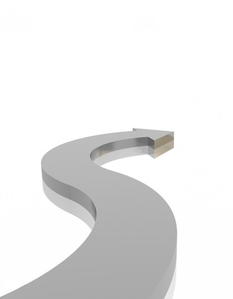
3D History
Revit, SketchUp, VRML (Reading)
FME 2014
X3D, 3D-Geometry Validation,
Hill-Shading
FME 2013
CityGML 2.0,
ADE Support
FME 2012
PointClouds, SketchUp Writer
FME 2011
SketchUp, Collada, GDB, Appearance
FME 2010
AutoDesk 3ds, CityGML, Wavefront OBJ
FME 2009
‘3D release’
CityGML Reader, Adobe PDF Writer, CSG
FME 2008
CityGML PlugIn
FME 2007
Enhanced Geometry Model
FME 2006
Notes:
Highlight Enhanced Geometry model, FME 2008 was a 3D Release, Point Clouds in 2011, Geometry validation, Revit, SketchUp

Slide 11
Scenarios I
Visualize 3D data (FME Data Inspector)
Format translation
Database loading
Data transformation from 2D to 3D
Integration of BIM, CAD, LiDAR and GIS data
Sharing and publishing 3D content
BIM / GIS integration
…

Slide 12
Scenarios II
Geometry model conversion
Build surface model from DTM or LiDAR
Drape 2d features on surface
Extract max height from DSM per building
Extrude from surface to height
Coloring and texturing of surfaces
Powerful xQuery options
3D validation + repairing
…

Slide 13
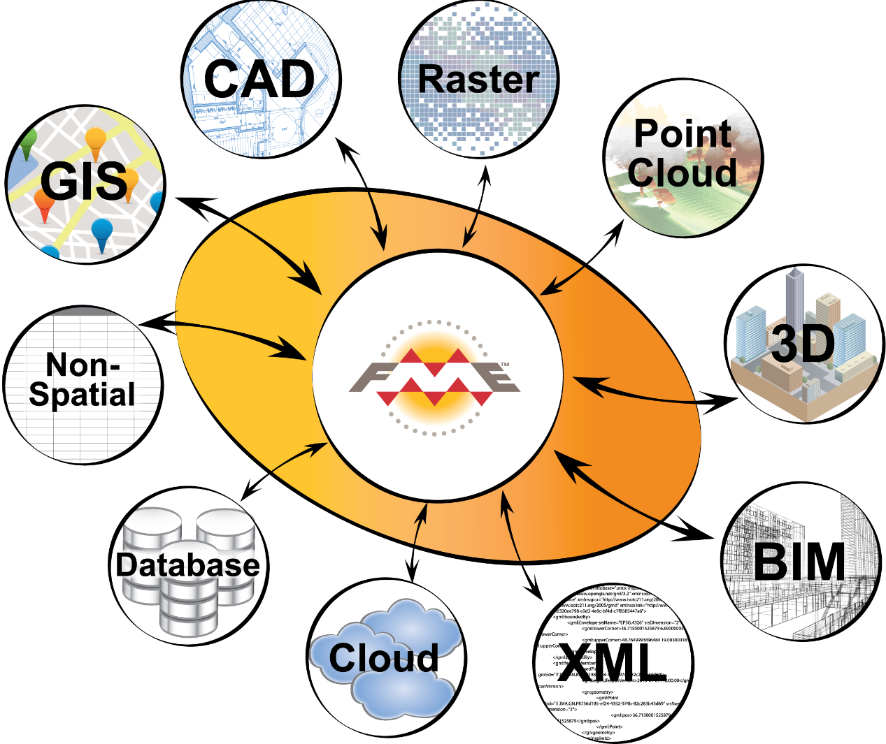
Formats

Slide 14
3D Formats
FME supports reading and writing a wide array of 3D data formats
  The extent of 3D support is limited by the level of each format’s own 3D support.
  Each combination of reader and writer will have its own unique characteristics and should be tested.

Slide 15
Sample #1
1:1-Translation between 3D Formats using FME Quick Translator
Pros
  Easy, quick results
  Textures are automatically translated, no user interaction
Cons
  No semantics
Notes:
Highlight textures, e.g.

Slide 16
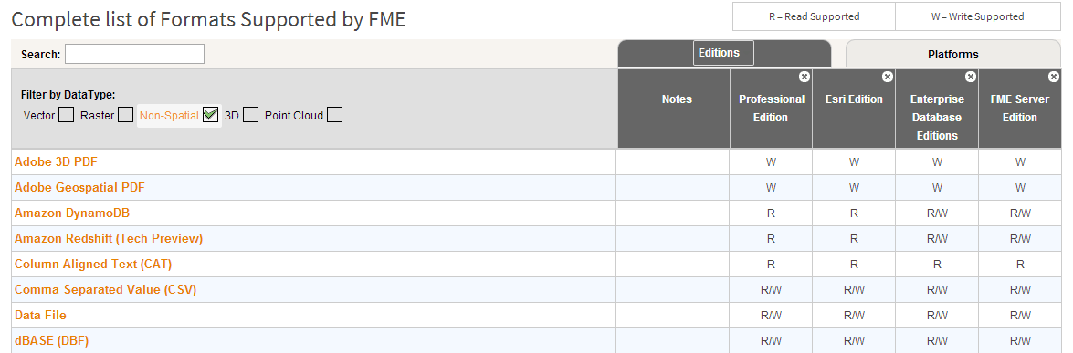
3D Formats
In this course
  3D PDF, CityGML, KML, IFC, SketchUp…
All formats
  http://www.safe.com/fme/format-search
  Filter: 3D

Slide 17
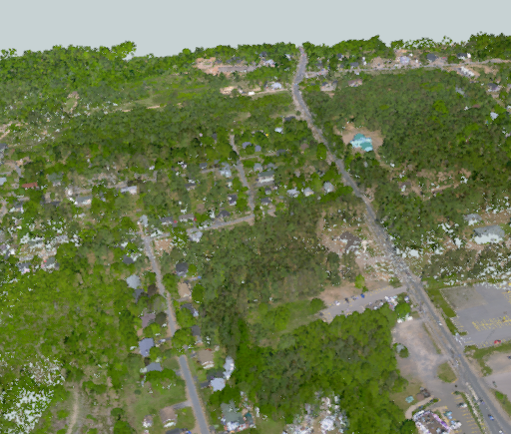
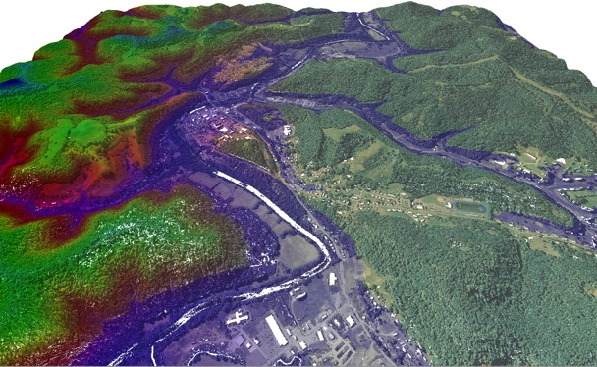
Point Clouds
Formats
New transformers
for component handling
PointCloudStatisticsCalculator

Slide 18
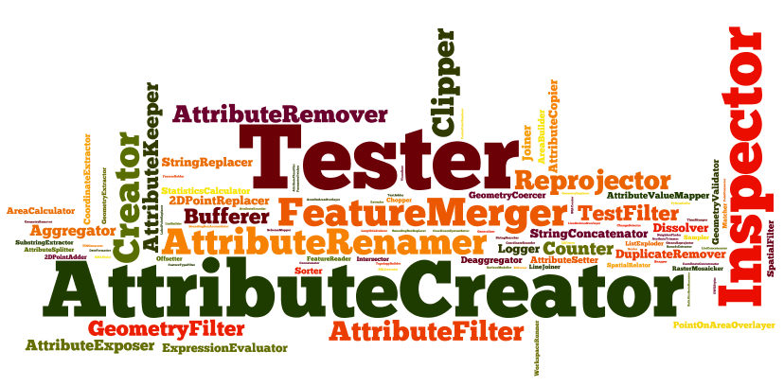
Transformers

Slide 19
Transformer groups
3D
  Extruder, 3DForcer, MeshMerger, SurfaceSplitter…
Surface model
  SurfaceModeller, TINGenerator, …
Texture and Appearance
  AppearanceSetter|Extractor|Styler|Joiner|Remover
Infrastructure
  Aggregator, Deaggregator, GeometryCoercer

Slide 20
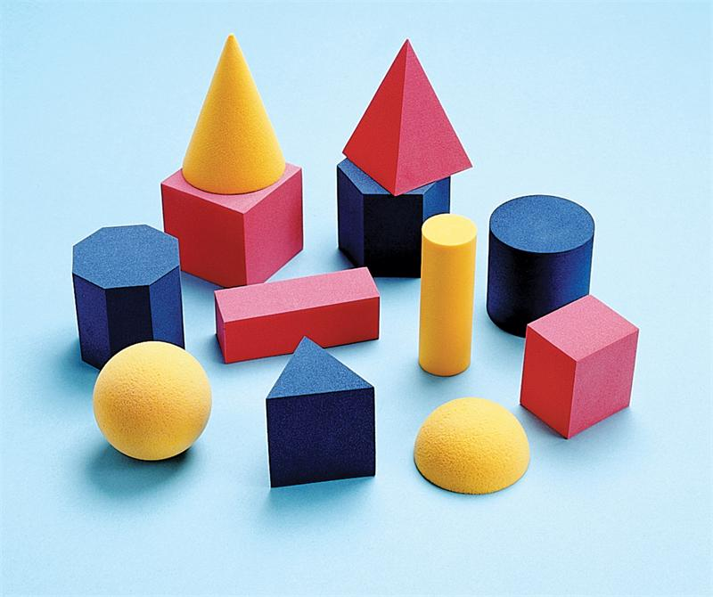
Geometry Model

Slide 21
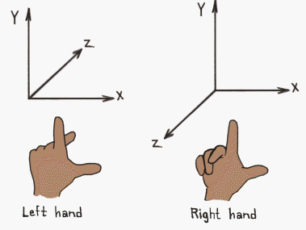
Geometry Model (3D)
FME supports two main different geometry types
  Surface and Solid
  One format supports solids and another supports only faces
  Geometry type conversion
FME uses a right-handed
coordinate system to determine
the orientation

Slide 22
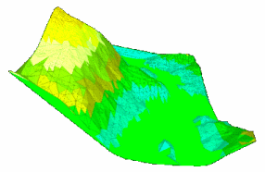
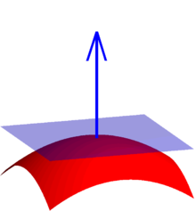
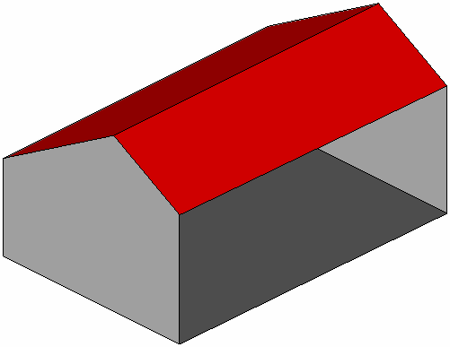
Surface and Solid I
Surface
  ‘Face’ is a planar area in 3D space
  Surface normal: a vector that points outwards perpendicular from the area
  IFMECompositeSurface, IFMEMultiSurface, IFMEMesh
Notes:
A surface model represents an infinitely thin shell that corresponds to the shape of a 3D object.
Mesh: A mesh model consists of vertices, edges, and faces that use polygonal representation (including triangles and quads) to define a 3D shape.

Slide 23
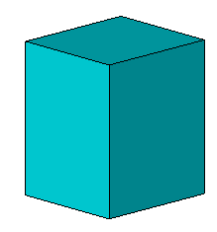


Surface and Solid II
Solids
  A solid is a volume (closed surface) in 3D space
  Defined by a collection of connected surfaces
  Solids can contain spatial voids
  IFMEExtrusion, IFMECompositeSolid, IFMEMulti-Solid, IFMECSGSolid
Notes:
Watertight
Constructive Solid Geometry

Slide 24
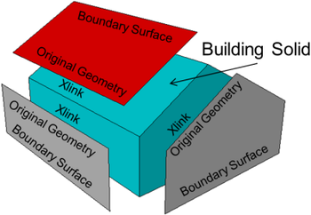
Sample #2
  Geometry type conversions between Solid and Surface geometry types
  Key Transformers
    GeometryCoercer
    Aggregator/ Deaggregator
    GeometryValidator

Slide 25
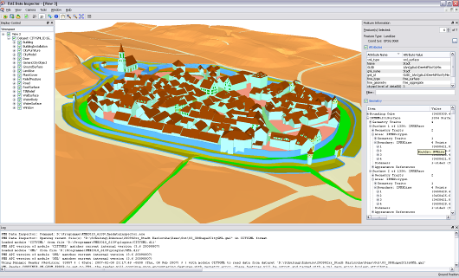
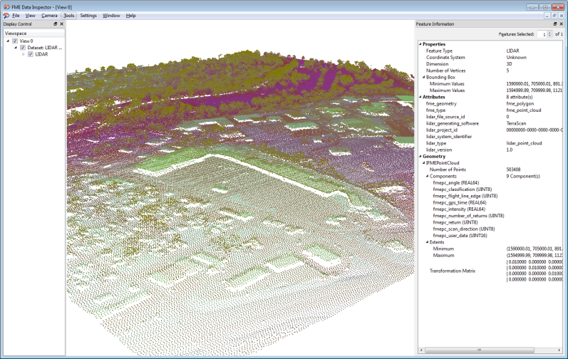
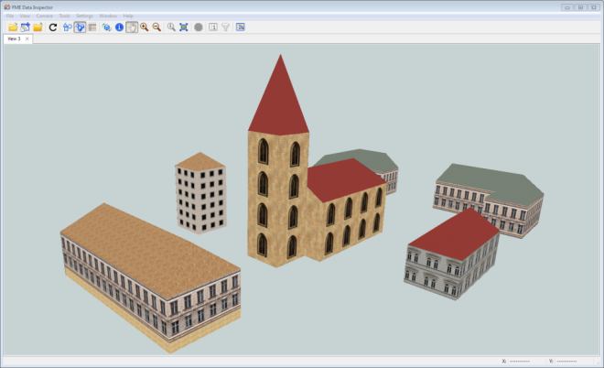
FME Data Inspector
FME Data Inspector can view both 2D and 3D
  Including Point Cloud data
Switch View (2D or 3D)
3D inspection tools
Notes:
Who is familiar with the FME Data Inspector?
Note: Switching view modes may take time, particularly if the Data Inspector engine is required to perform extensive spatial indexing for 3D mode.

Slide 26
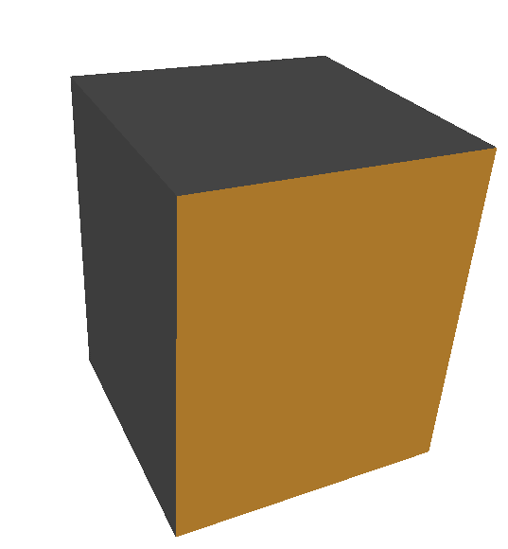
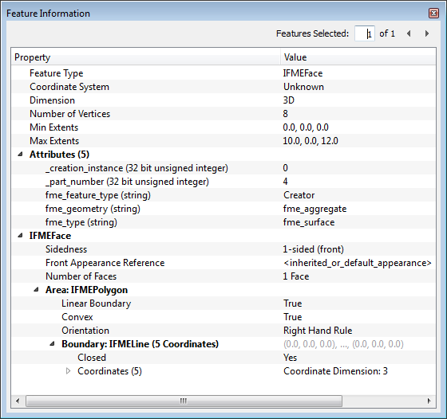
FME Data Inspector
3D geometry properties

Slide 27
Chapter II
Create 3D models from 2D data

Slide 28
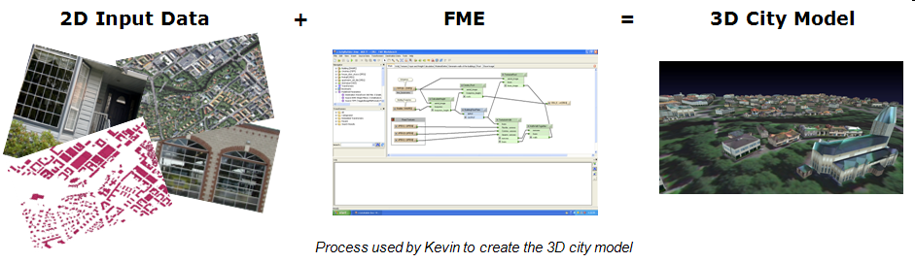
Introduction
Create 3D models from 2D data
  Common workflow in FME
  Input could be any 2D or 2.5D data

Slide 29
Create 3D models from 2D data
Input data
  Building footprints
  Land Use information (vegetation, water, traffic)
  CAD drawings
  Heights
  LiDAR data
  Orthophotos
  Non-spatial data (adresses, metadata)
Notes:
We will use some of them but not all

Slide 30
Transformers
Extruder
  Creates line, surface or solid geometries with a fixed cross-sectional profile taken from the original geometry of the feature.
3DForcer
  Turns two-dimensional data into three-dimensional data by adding a (the same) z-value to every coordinate.

Slide 31
Sample #3
Create a simple building block model (LoD1)
  Read 2D building footprints (2d polygons)
  Extrude polygons by heights from attribute
  Write 3D Shape file

Slide 32
Transformers
GeometryCoercer
  Resets the geometry type of the feature (e.g. from solid to surface)
Aggregator / Deaggregator
FaceReplacer
Orientor / OrientationExtractor
Chopper
  Breaks input features into points, lines, or areas.

Slide 33
Transformers
SurfaceModeller and SurfaceDraper
  Assign individual z-values to every coordinate (by interpolation from a surface model)
PointOnRasterValueExtractor
  Extracts the band and palette values from a raster at the location of each input point and sets them as attributes on the feature.

Slide 34
Sample #4
Create a 3D vegetation model
  Read trees location (x,y) (tree cadastre)
  Calculate z-value for x,y location from terrain model
  Read OBJ-tree models and offset to x,y,z location
  Scale tree models
  Write 3D PDF

Slide 35
Exercise #1
Creation of a 3D city model from different data sources.
  laser scan data
  building ground plans (building footprints)

Slide 36
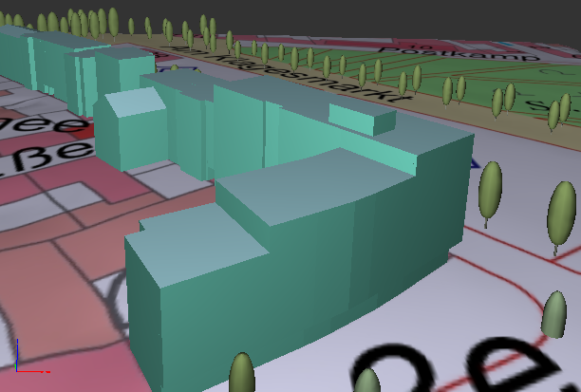
Sample #5
Create a 3D City Model
  Sample 4
  Add Terrain with map overlay
  Buildings

Slide 37
Exercise #2
Continue from Exercise #1
Calculate true z-values and heights for buildings. Add the terrain model with orthophoto. Write the output to 3D PDF.

Slide 38
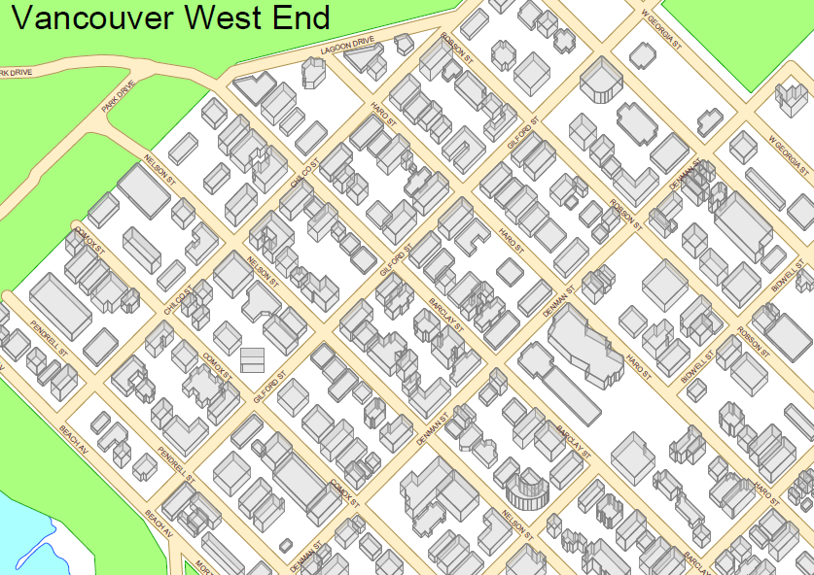
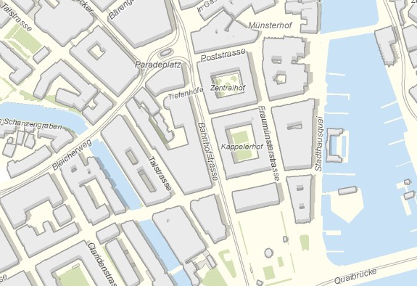
From 3D to 2.5D
http://fmepedia.safe.com/articles/Samples_and_Demos/Generating-3D-building-models-from-2D-data

Slide 39
Chapter III
CityGML Reading and Writing

Slide 40

CityGML
CityGML is a data model and exchange format for virtual 3D city models
Modeling of all relevant parts of a virtual city according to their semantics, geometry, topology and appearance
GML 3 application schema (XML based)
CityGML 1.0.0 is OGC Standard since 2008
  Current version is 2.0.0
Notes:
Sharing information about 3d cities

Slide 41
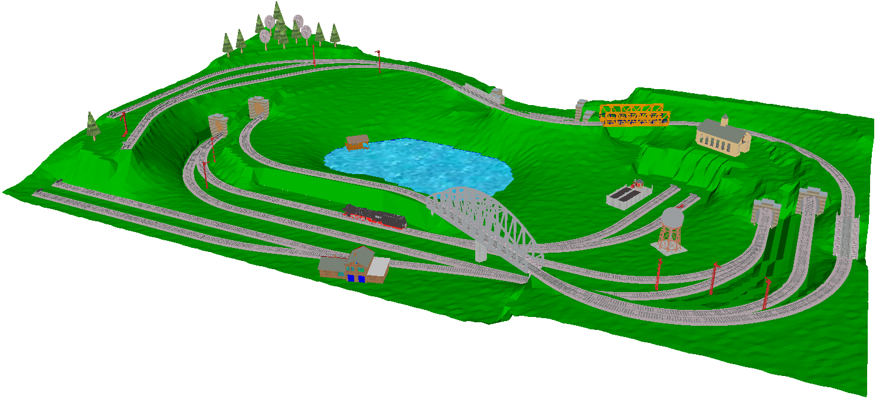
A real-world CityGML example
WaterBody Module
Vegetation Module
CityFurniture Module
Relief Module
Tunnel Module
Bridge Module
Building Module
Transportation Module
Notes:
14 Module (u. a. CityGML_Core und Building)
119 Elemente gesamt + GML Geometrie + xAL Adressen

Slide 42
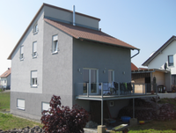
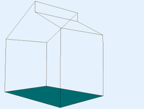

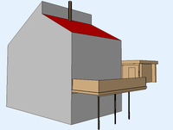
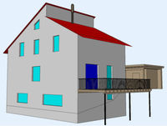
CityGML | Characteristics I
Multi-Scale Modeling (Level of Detail)
  From LoD 0 up to LoD4
  From landscape up to interior model
LoD 0
LoD 1
LoD 2
LoD 3

Slide 43
CityGML | Characteristics II
Coherence of semantics and geometry
  Explicit relations between semantic objects and their geometrical representation (B-Rep)
External References
Appearance (Textures)
Application Domain Extensions (ADE)
Generic city objects and attributes
…

Slide 44
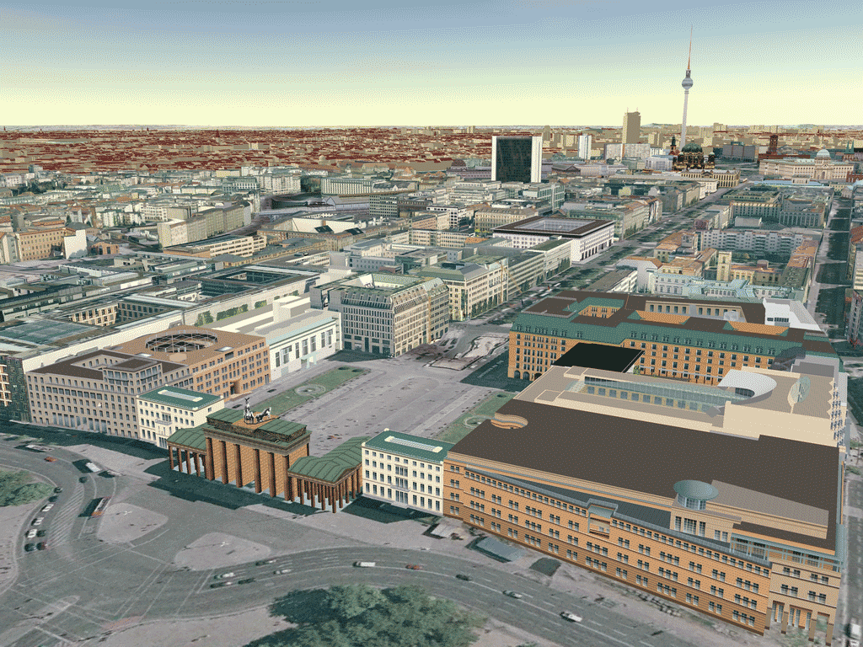
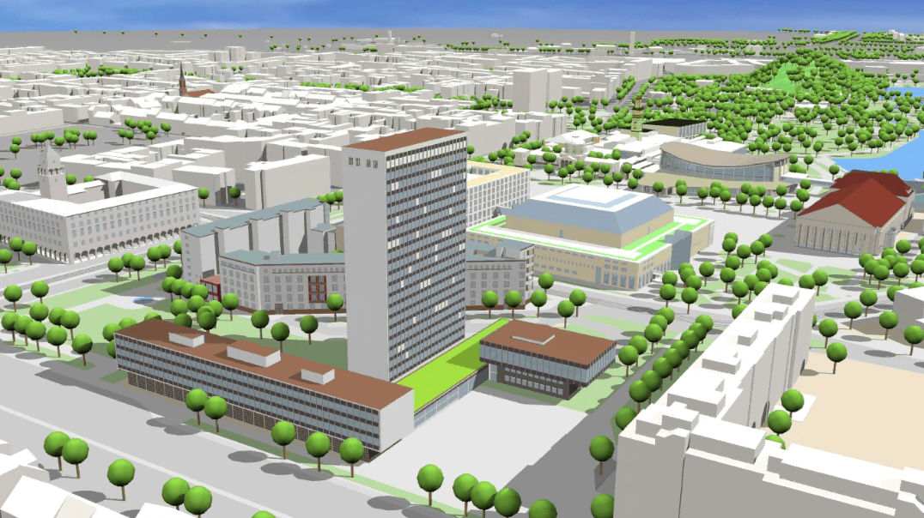
CityGML samples
City of Berlin (© virtualcitySYSTEMS)
City of Karlsruhe

Slide 45
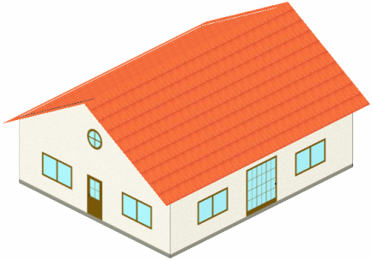

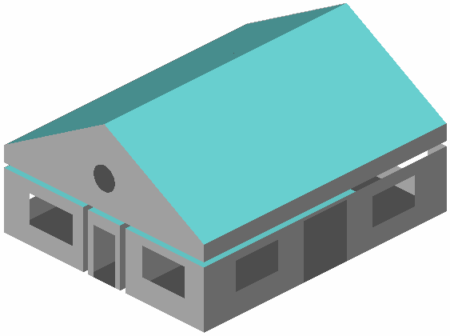
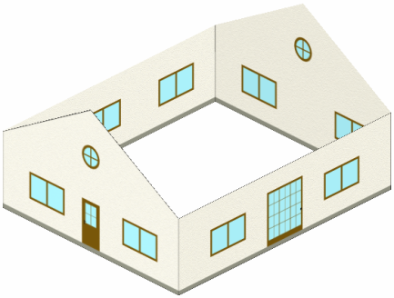
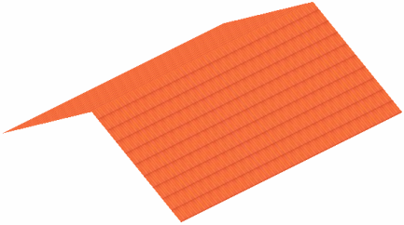


Building structure
Building
boundedBy
interiorRoom
outer shell
Rooms
boundedBy
boundedBy
Ceiling
Wall
Roof
inner Walls
Ground

Slide 46
Building properties
GML attributes
  name, description, boundedBy,…
Core attributes
  creationDate, terminationDate, relativeToTerrain, relativeToWater, externalReference, generalizesTo
Building attributes
  class, function, usage, yearOfConstruction, yearOfDemolition, roofType, measuredHight, storeysAboveGround, storeysBelowGround, storeyHeightsAbove|BelowGround, address

Slide 47
FME's support for CityGML
Reading and writing CityGML up to version 2.0
FME supports
  All thematic modules
  Level of Detail (LoD 0-4)
  Attributes and properties (e.g. addresses)
  Generic objects and attributes
Support for any arbitrary ADE
  E.g. IMGeo ADE, Noise
Notes:
Only minor issues or not supported properties (writing xlinks)

Slide 48
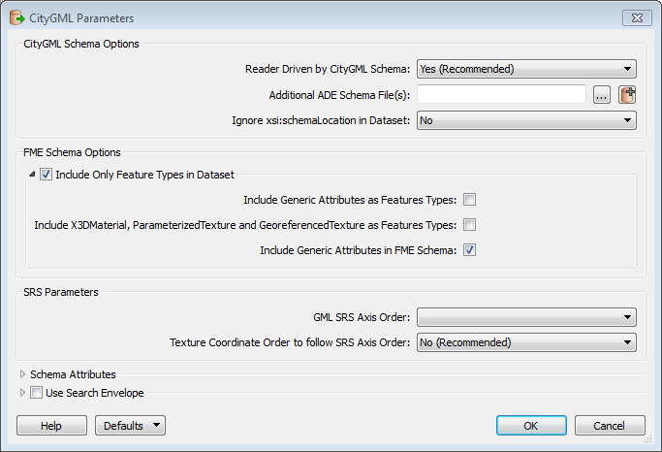
Reading CityGML
Parameters
  Reader Driven by CityGML Schema
  Additional ADE Schema file(s)
  Ingnore xsi:schemaLocation
  Include Only Feature Types in Dataset
Reading CityGML containing xlinks

Slide 49
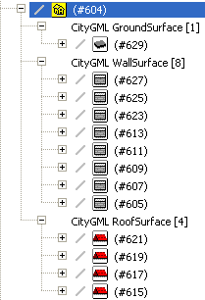
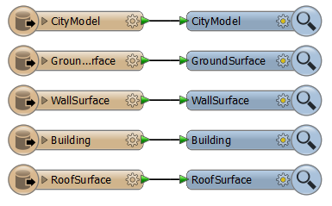

Reading CityGML
One Feature Type per CityGML feature

Slide 50
Sample #6 Reading CityGML

Slide 51
Writing CityGML (notes)
Writing CityGML is not straight forward
Requieres knowledge of
  CityGML in general
  CityGML Specification Document
    http://www.opengeospatial.org/standards/citygml
    CityGML UML diagrams
  How to adopt CityGML properties within FME

Slide 52
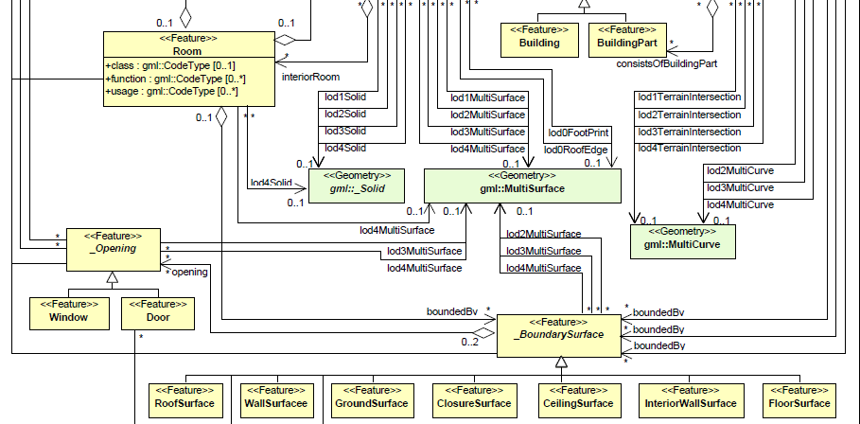
Writing CityGML

Slide 53
Workflow for writing CityGML
Read and prepare source data
Set CityGML geometry properties
Build relationship between features
Prepare FME Feature Types
Adjust Writer Properties

Slide 54
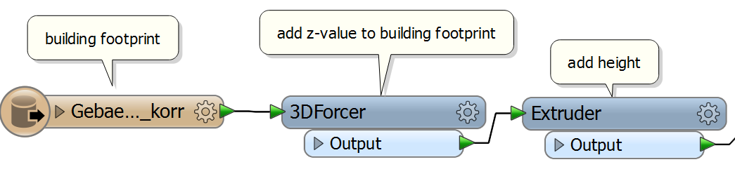
Read and prepare source data
Read your data (it could be any kind of data)
Prepare your data

Slide 55
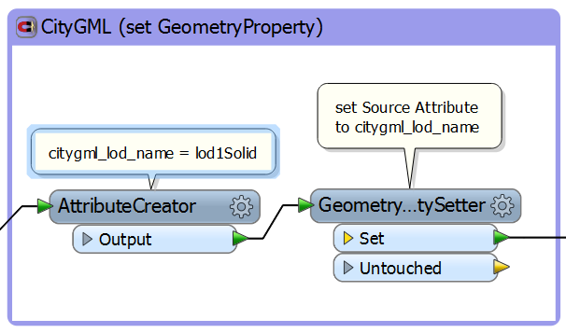
Set CityGML geometry properties
Set CityGML specific geometry property
  CityGML format attribute citygml_lod_name
  e.g. lod1Solid, lod2MultiSurface, …
  Set Geometry Trait with GeometryPropertySetter

Slide 56
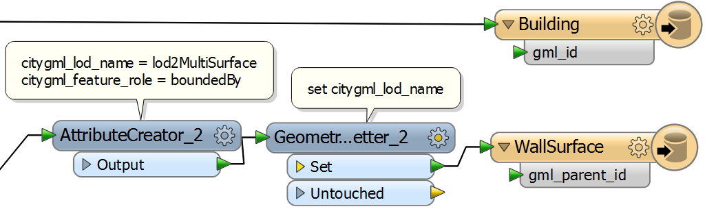
Build relationship between features
  Use gml_id and gml_parent_id for relation
    Assign parent’s gml_id to child gml_parent_id
Set relationship between features
  CityGML format attribute citygml_feature_role
  e.g. boundedBy, consistsOfBuildingPart

Slide 57
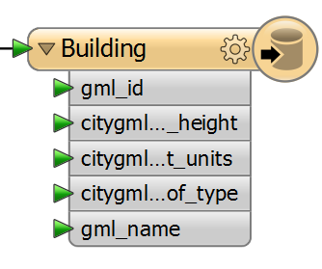
Prepare FME Feature Types
Manually add or import CityGML Feature Types
Choose from predefined Format Attributes or add User Attributes
User Attributes will be written as Generic Attributes
Building, Room,
SolitaryVegetationObject,…

Slide 58
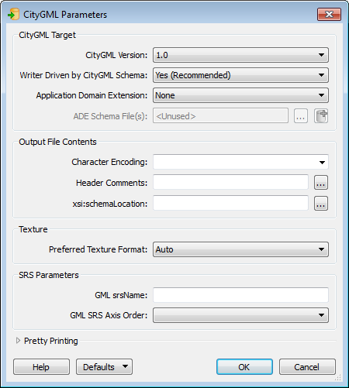
Adjust Writer Properties
CityGML Version
Application Domain Ext.
Header Comments
GML srsName
GML SRS Axis Order
Pretty Printing Options

Slide 59
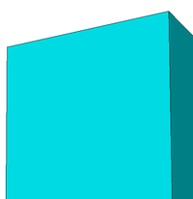
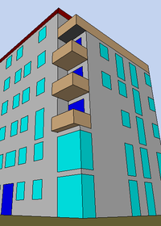
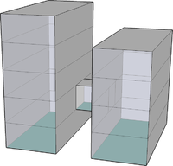
Sample #7, 8, 9 Writing CityGML

Slide 60
General notes
Be careful with exact naming and word spelling for
  Feature Types: Building ≠ building ≠ BuildinG
  Attribute names: citygml_lod_name ≠ citygmllodname
  Attribute values: boundedBy ≠ Boundedby
  Geometry properties: lod1Solid not LOD1solid

Slide 61
Exercise #3
You are going to design a workspace transforming SketchUp 3D Building models into CityGML format.

Slide 62
Q&A - Best Practise

Slide 63
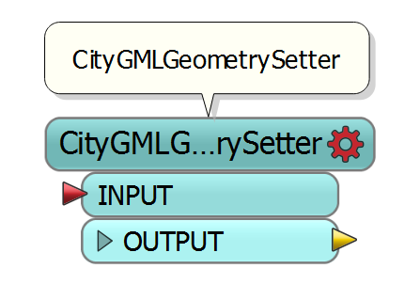
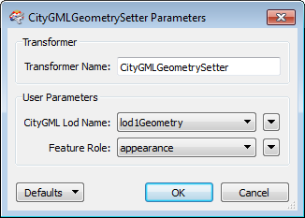
CityGMLGeometrySetter

Slide 64
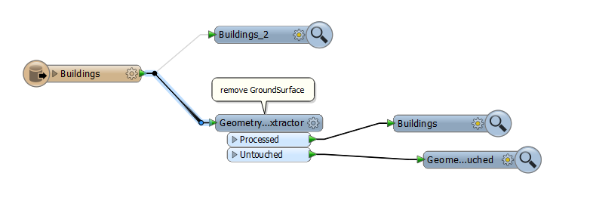
XQuery
for $geom in //geometry
where fme:trait-equals
(fme:get-trait($geom, 'sketchup_layer_name'),
'Building-1_GroundSurface')
return number($geom/@fme_id)

Slide 65
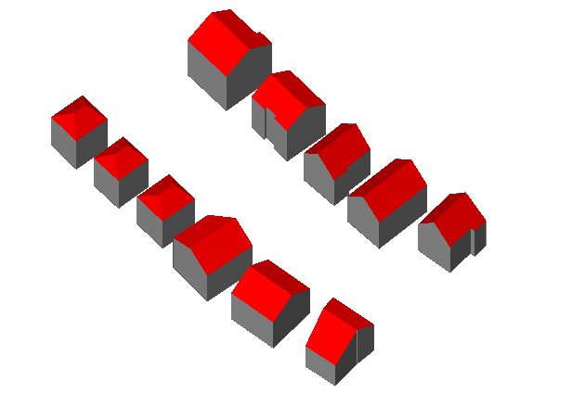
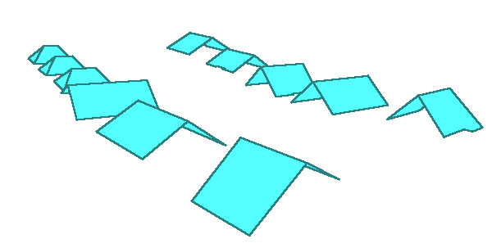
From Roofs to Buildings

Slide 66

CSG Geometry
Using CSGBuilder
and CSGEvaluator

Slide 67





Building Information Modeling
gbXML
CityGML
BIM
IFC
Architecture,
Engineering,
Construction
GIS
ALKIS,
INSPIRE,
OSM
© KIT Karlsruhe
Notes:
IFC Industry Foundation Classes - detailed models from single Buildings
GreenBuilding many attributes and further properties (energy simulation)
CityGML – urban and Landscape models (different levels of detail)

Slide 68

IFC vs. CityGML
Walls Sample

Slide 69

Revit

Slide 70
Building Information Modeling
 | IFC | CityGML
Application area | Architecture | GIS
No. of entities | 653 | 119 Features + GML
Scope | Single Building (s) | City or Landscape
Geometrie | „Parametrisch“ | explicitly
Level of Detail | Nur implizit | 5 Level of Detail
Extension | Property sets | Application Domain Extension (ADE) New features and attributes

Slide 71
Summary & Wrap-Up

Slide 72
Resources
FME Readers & Writers
  http://docs.safe.com/fme/html/FME_ReadersWriters/Default.htm
FMEpedia
  http://fmepedia.safe.com/topic/3D
  http://fmepedia.safe.com/topic/Point-Cloud
FME Channel on Youtube

Slide 73
Resources
CityGML Specification
  http://www.opengeospatial.org/standards/citygml
SIG 3D Quality and Modeling Working Group
  http://wiki.quality.sig3d.org/index.php/Hauptseite
FZK Viewer
  http://www.iai.fzk.de/wwwextern/index.php?id=1134
3D City DB
  https://github.com/3dcitydb

Slide 74

Thank You!
For more information:
  con terra GmbH
  fme@conterra.de
  Christian Dahmen
  c.dahmen@conterra.de
  @cda4all
CONNECT. TRANSFORM. AUTOMATE.

