Slide 1


Reliability and Power of FME: STARS Air Ambulance Saves Lives
Paul Wiles
Technology Specialist
Notes:
--- (Thank group for opportunity to share information about how we use FME at STARS. ) ----
Hello everyone, my name is Paul Wiles
I have worked at STARS for several years now managing the GIS and I have been working with FME for four years.
During this presentation, I will discuss the reliability and the power of FME and how it accomplishes our tasks – helping us save lives.

Slide 2
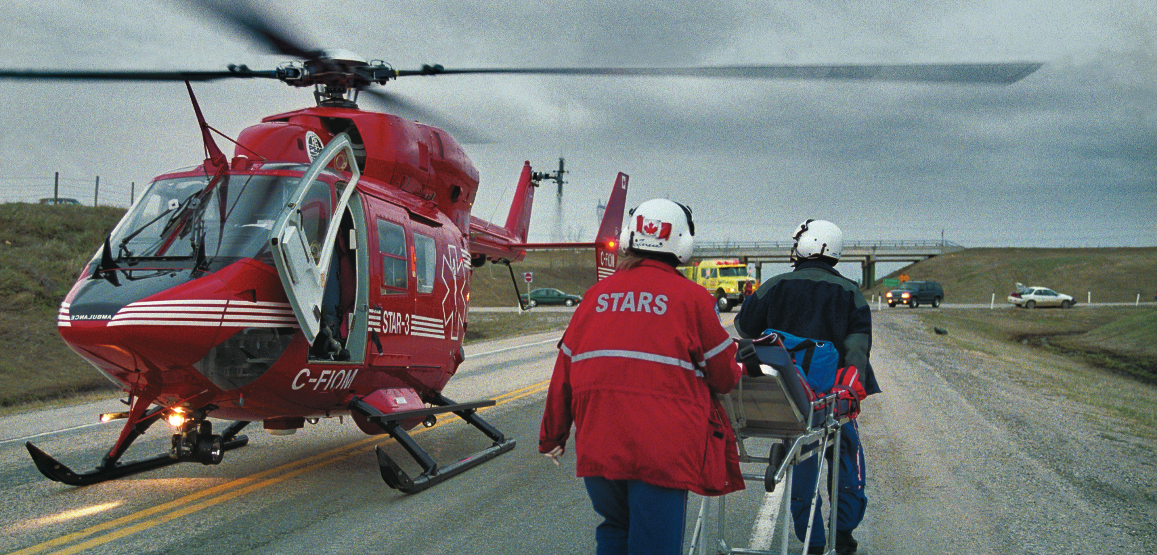

About STARS
Notes:
Last year STARS flew more than 1,400 missions – that’s , almost 4 missions a day.
Our mission is to provide a safe, rapid, highly specialized, emergency medical transport system for the critically ill and injured.
Our vision is saving lives through partnership, innovation and leadership.
Innovation is the key point I would like to make at this user conference.

Slide 3
About STARS Con’t
3 types of GIS platforms
  ArcGIS
  Map Objects (Positron CAD)
  Google
Notes:
With respect to innovation:
We use 3 GIS apps at STARS, Arc, our CAD ( A map objects based app) and Google.
ArcGIS - for mapping with industry call takers
Map Objects application (Power Map) – used for our dispatchers
- Our CAD (Computer Aided Dispatch) system is used for various tasks and the main task that I am hear to talk about is the mapping component.
Google – Flight following, viewing industry sites registered with STARS and for the imagery component.

Slide 4
FME role at STARS
Convert XLS to Shape
Clip large datasets
Point connector transformer
Notes:
I think we use just a small amount of the full potential on what FME can do, but each of these tasks helps me and provides me with more time in my day.
FME converts my excel documents to Shape files. We have users that update documents for me, with unique locations identified by a name and a Lat and long. They input them in this document, I run the workbench file and export to predefined locations.
Large datasets of Western Canada need to be clipped to fit within our coverage areas. Examples of this will be shown in future slides.
NVG (Night Vision Goggle) routes are used by inputting data in a excel spreadsheet. Now that these points are defined, FME goes to work; it converts to a shape file using a Point connector transformer to create the lines. This will be shown in future slides.

Slide 5
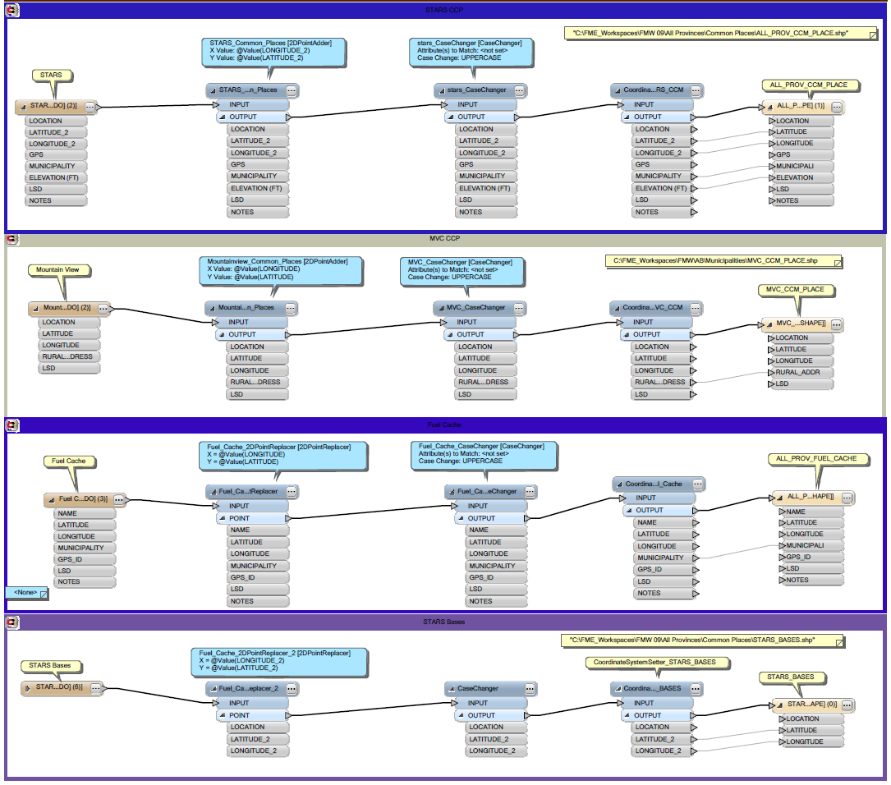
CCMP Custom Translations
Notes:
CCMP is our custom common meeting place layer and it is used to define unique locations.
This is a example of one of our workbench files witch displays the translation from excel to shape.

Slide 6
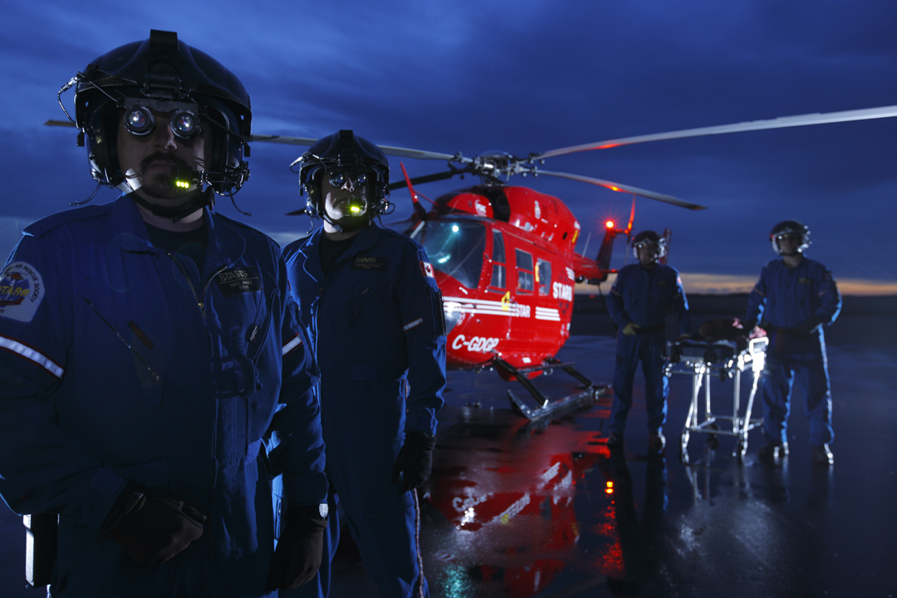
NVG Routes
Notes:
STARS operates five BK117 helicopters with two pilots on every flight.
We are the only non-military service in Canada to fly at night with night vision goggles, (the only option at night), SAR capabilities etc. Two addition helicopters allow STARS to continue operating at full capacity when helicopter maintenance occurs, or there is a need for immediate spare parts.
Pilots have a minimum 3,000 helicopter flying hours. All are instrument flying rated and are air transport licensed.

Slide 7
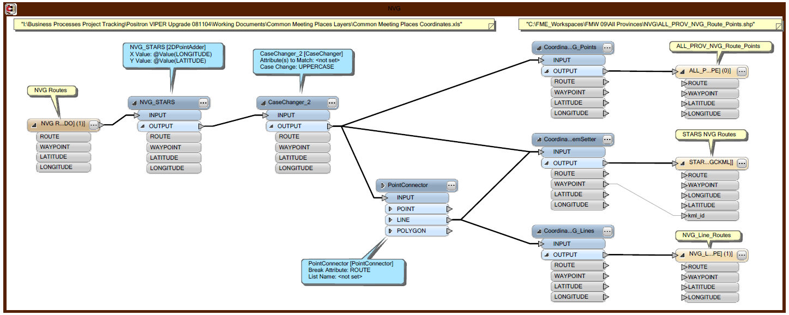
NVG Route Creations
Notes:
In this slide, you can already see that the original file is a excel document.
I've added a 2d Point addresser, Point connector, coordinate setters and final results – are the shape files and KML file.
Hopefully in the future, I will incorporate the tourbuilder to provide the fly-through for these pilots.

Slide 8
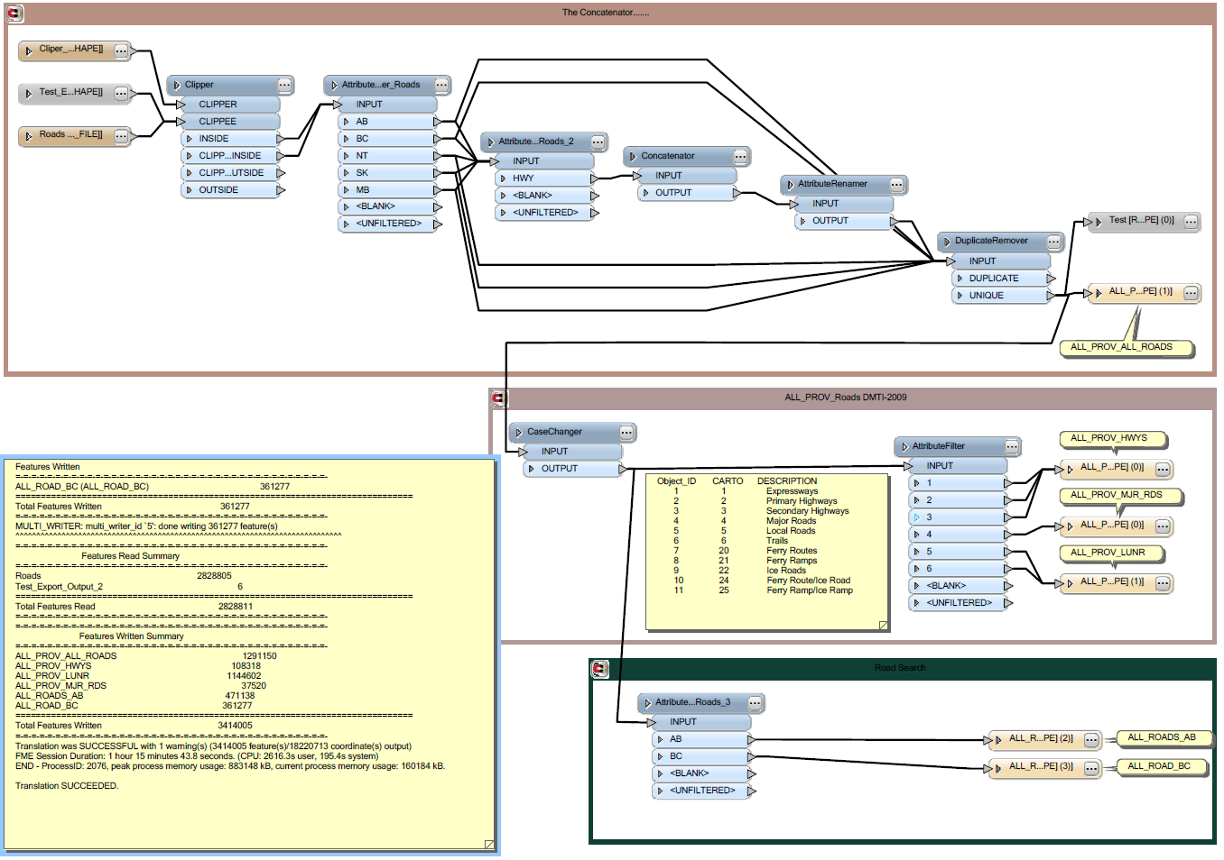
The Concatenator ☺
Notes:
I like this tool, it provides me the ability to modify our road network for half of Canada in just over a hour. I move the new data in the location where this runs – Run the program and walk away.
When it was done, it clipped 2.8 million roads in Canada to only 1.3 million roads for our coverage area in western Canada.

Slide 9
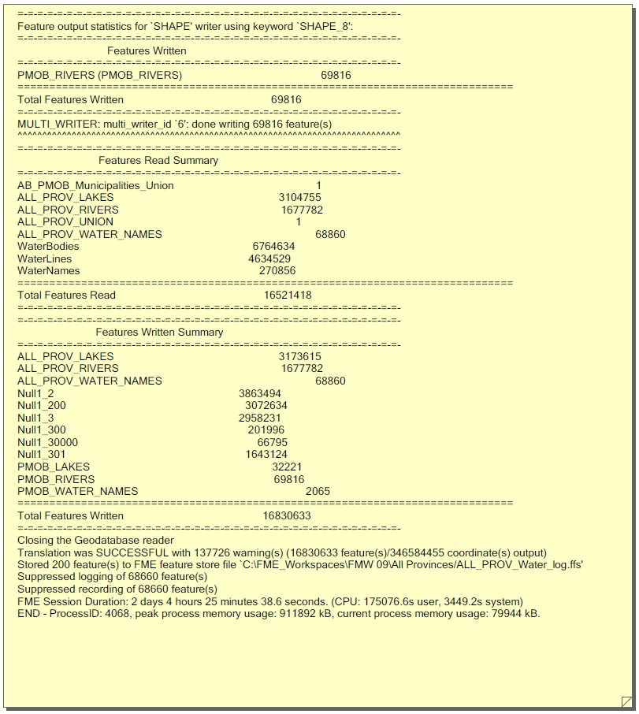
Water Layers
Notes:
Before I go to the next slide I wanted to point our the result of this workbench file:
16,830,633 Water features read
2 days, 4 hours and 25 minutes to complete
This displays water lakes & rivers and names.
Being able to walk away from this application and let it chug away for a few days is pretty impressive.
This again displays the reliability of this application.
The next slide will display my workbench file.

Slide 10
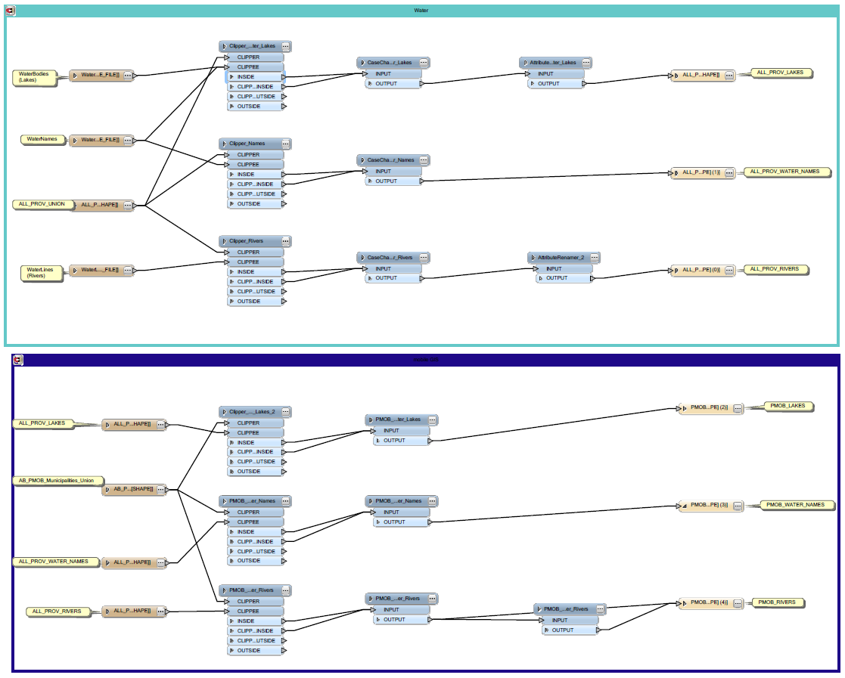
Water Con’t
Notes:
This is the very straight forward workbench that I use to complete this task.

Slide 11
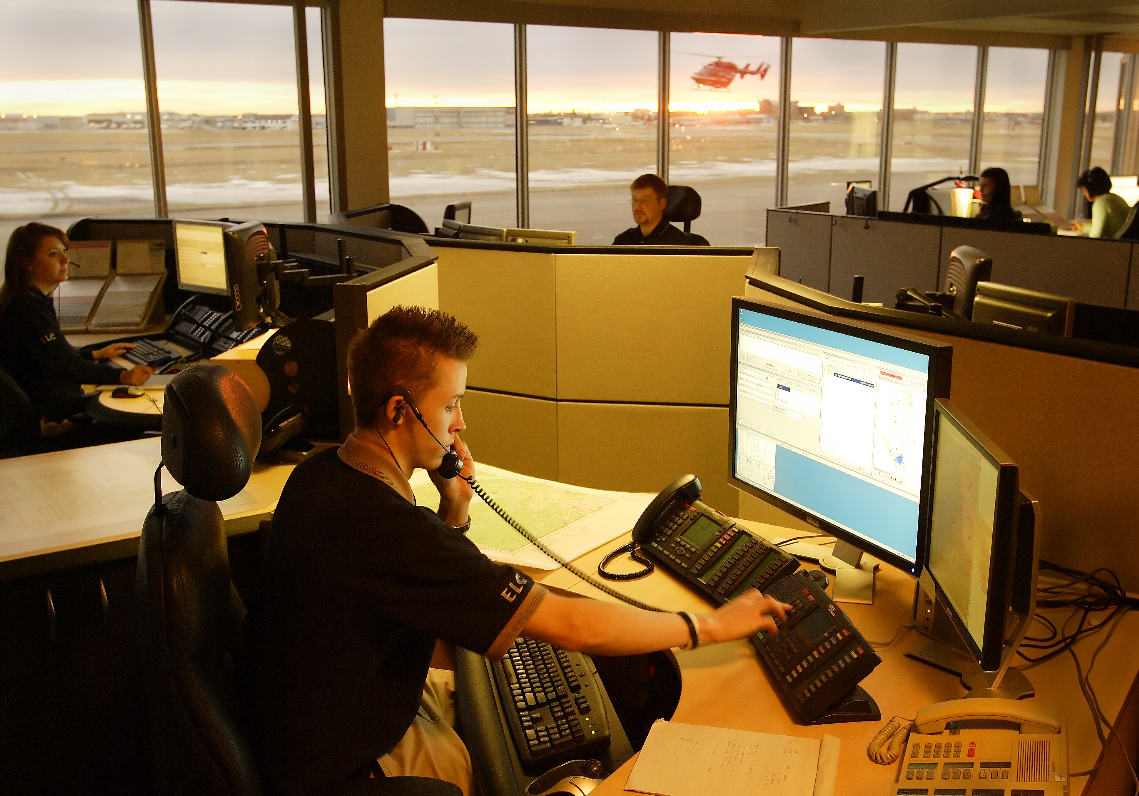
STARS Emergency Link Center
Notes:
FME is transparent to the end users in our dispatch center. While FME is rolling out new updates to the PC’s, the users are performing their regular duties.
An example of these updates is by pushing shape files to live environments and training environments.
Why: because we are a 24 hrs operation and updates must be done transparently.
It is nice to have applications that run as well as this one and if any asks me about specific GIS tools, I always mention FME because of these situations.

Slide 12
STARS Future
Notes:
Our new helicopter;
The AW139; nearly double the range, 25% faster and capable of flying more patients in extreme conditions.
FME will help me in the near future to create required datasets, for these expanded coverage areas.
I'm sure like always, this will be simple for this application.

Slide 13
Thank you
Notes:
Thanks for providing me this opportunity. I look forward to using additional components of this application and to provide feedback on how well it was working for me.
As a side note: It is nice to see the developers listening to the users. A little while ago, I submitted my request to be able to disable all of the features in the bookmark tab, 2 conferences ago. It was done a few releases later. I encourage everyone to take the time, when working with this application to provide feedback. It will help you and all the people around us.
Thanks

Slide 14
Questions?

Slide 15
Contact Information
Paul Wiles
pwiles@stars.ca
403-299-2400

